Slide 1
Bots, Bots, and More Bots
Lets build a chat bot today

Slide 2



Speakers
Alex Fagundes
Director / Chief Architect
PowerObjects, an HCL Company
Jason Lattimer
Development Manager
PowerObjects, an HCL Company

Slide 3
Agenda
Chat bots vs Voice IVR vs Web
Microsoft Chat Bot SDK
QnA Maker (this is cool)
Live demo
Deployment options
Logging
Automating last piece

Slide 4

Survey
How many have played with QnA Maker?
How many have played with chat bots?

Slide 5
IVR / Web KB / Chat Bot
IVR
Voice getting better but not there yet.
Consumers don’t like it
60-80% rather bypass it
Many are considered ‘failed’ implementations but still in use.
Expensive!!!
Web Search (KB)
Consumers use it
Most companies have many internal and external KBs.
Often not well indexed and needs precise spelling hit.
Poor deflection

Slide 6
Chat Bots
Chat Bot
Much easier to ‘translate’ question than voice
Faster than IVR
Consolidate and re-use existing info (no need to ‘move’ your data)
Unlike IVR, consumers and employees like it.
MS Chat Bot
Framework / SDK
Templates built with SDK
Very inexpensive to get going
Very quick for a V1 deployment

Slide 7
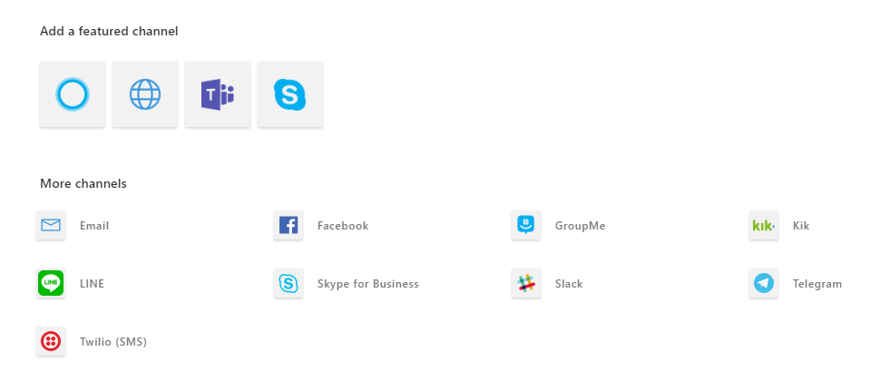
Microsoft Chat Bot Framework
MS Azure Chat Bot
Web app
https://xxxx
Chat bot Cognitive services
Channels

Slide 8
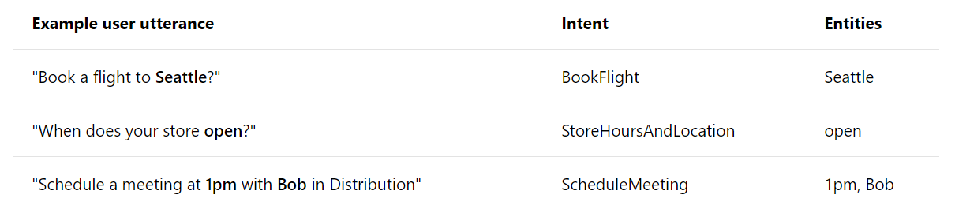
QnA Maker
Search engine on steroids.
Point and click
Leverages Azure Search
Consumes web pages
Consumes files (.xls, csv)
QnA maker can be stand alone!
https://www.qnamaker.ai/
Leverages LUIS (language understanding service)

Slide 9
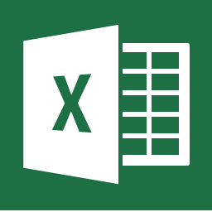

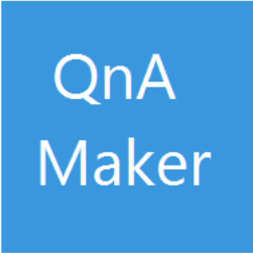



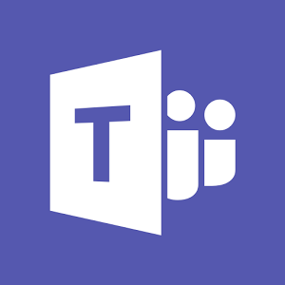
What are we building today?
CrmUG FAQ
Informational Q&A chat bot
Ask a question and it will answer it
Leverage QnA Maker
Consume CRM UG FAQ
Consume a single .xls File
QnA maker Best Practices
Channels
Web app / html page channel
SMS Channel
Skype channel
MS Chat Bot

Slide 10
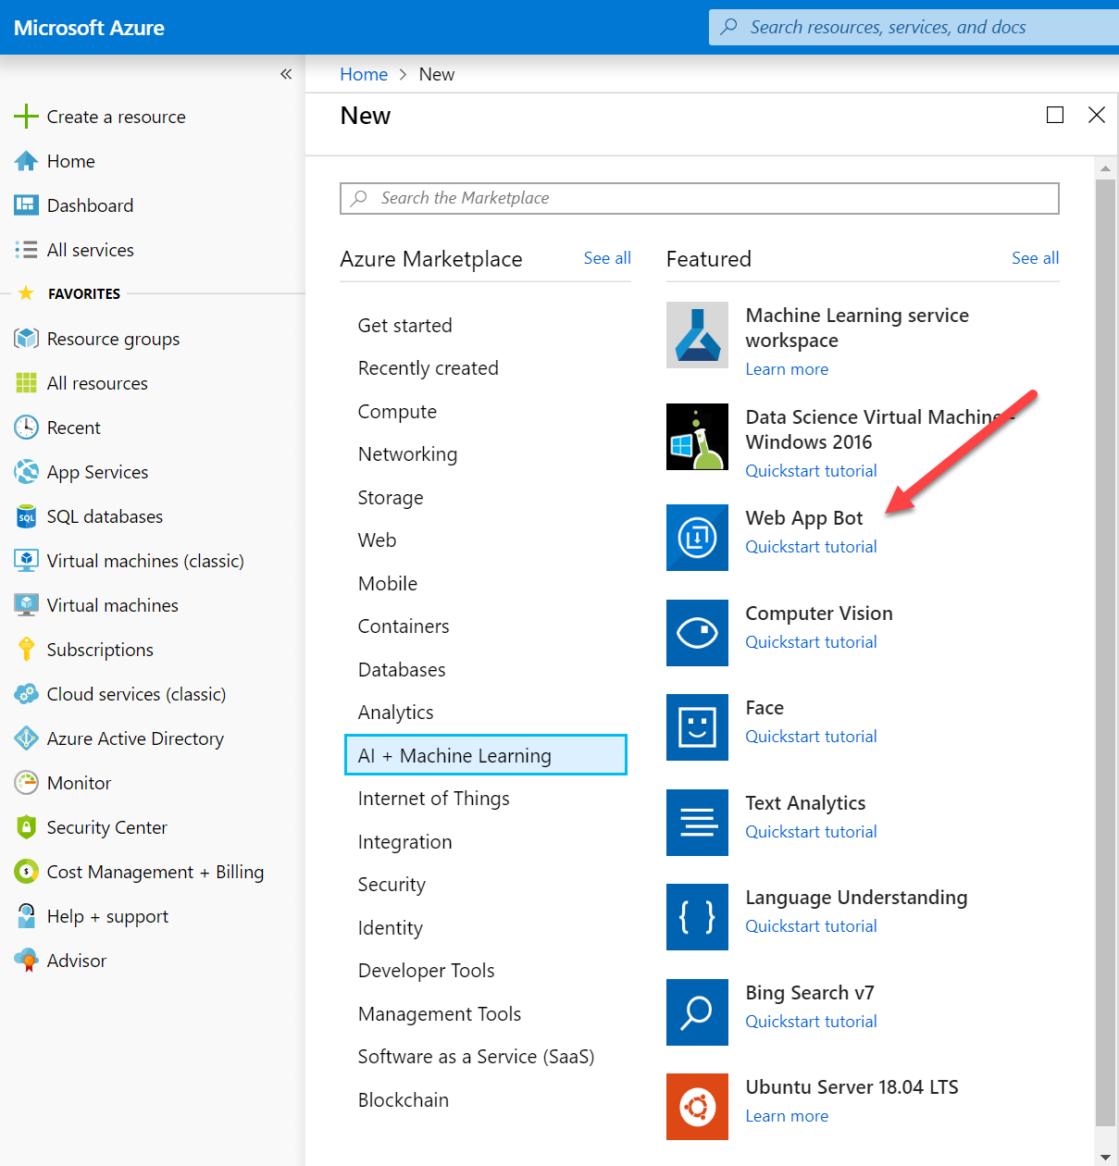
Lets Deploy Chat Bot (live demo)

Slide 11
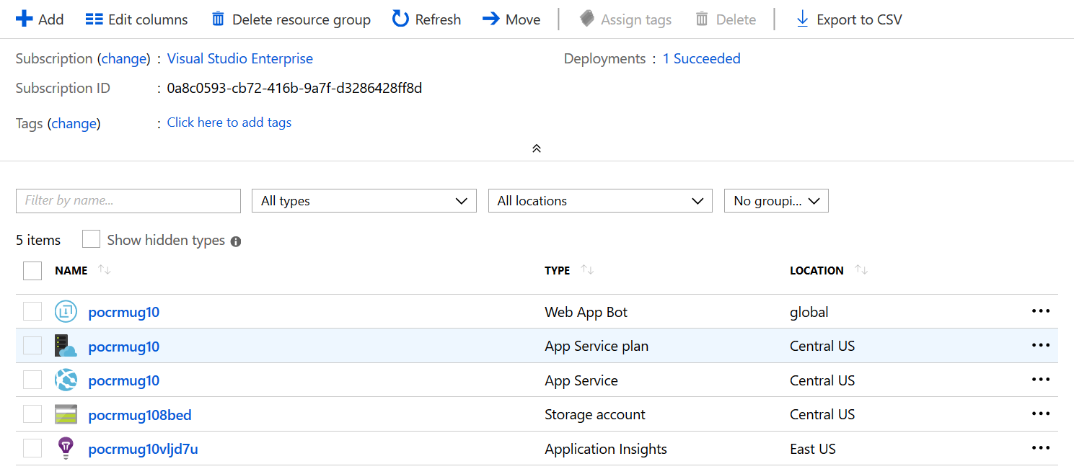
Chat Bot – components?

Slide 12
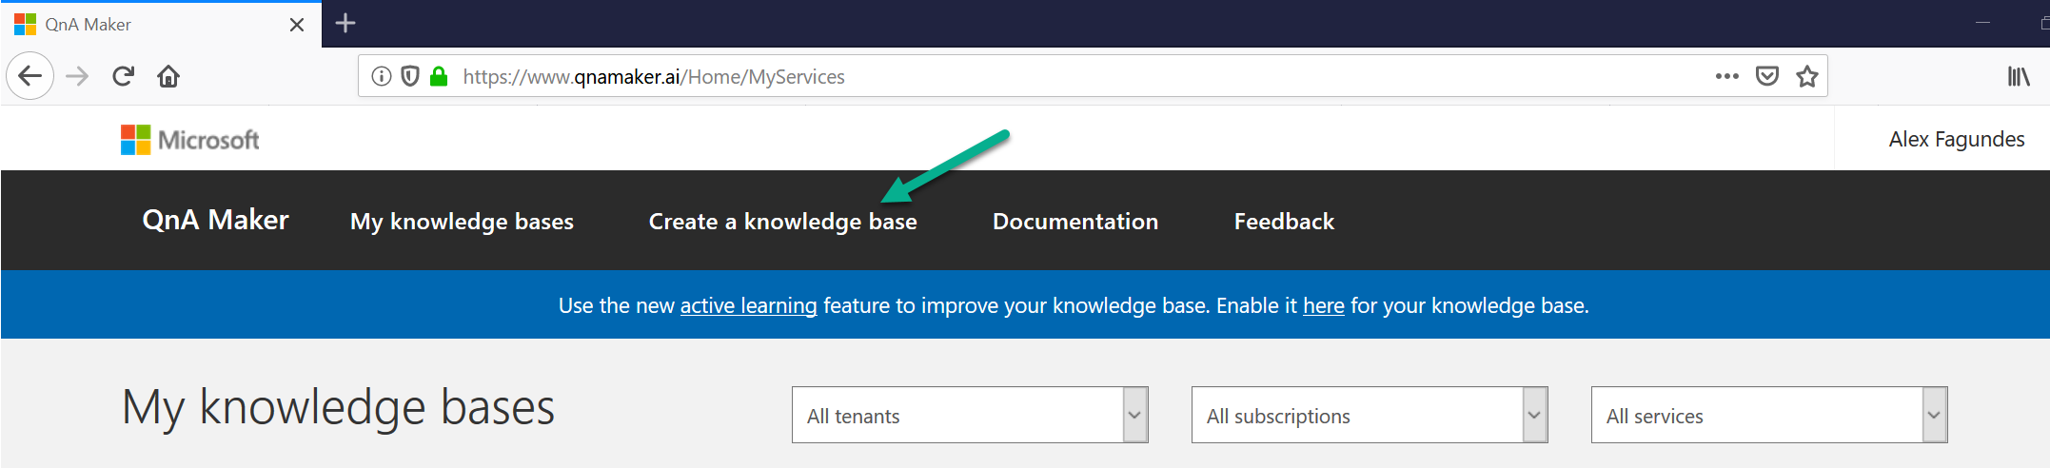
Lets Deploy QnA Maker (live demo)

Slide 13
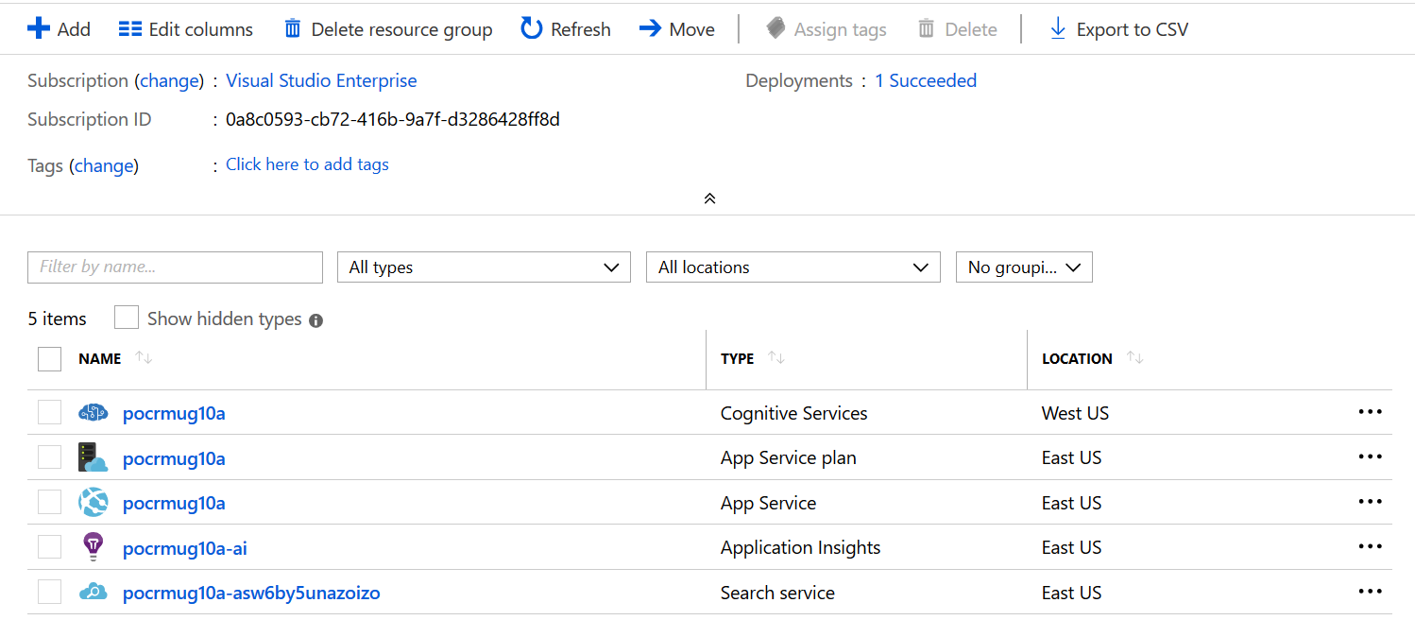
QnA Maker – components?

Slide 14
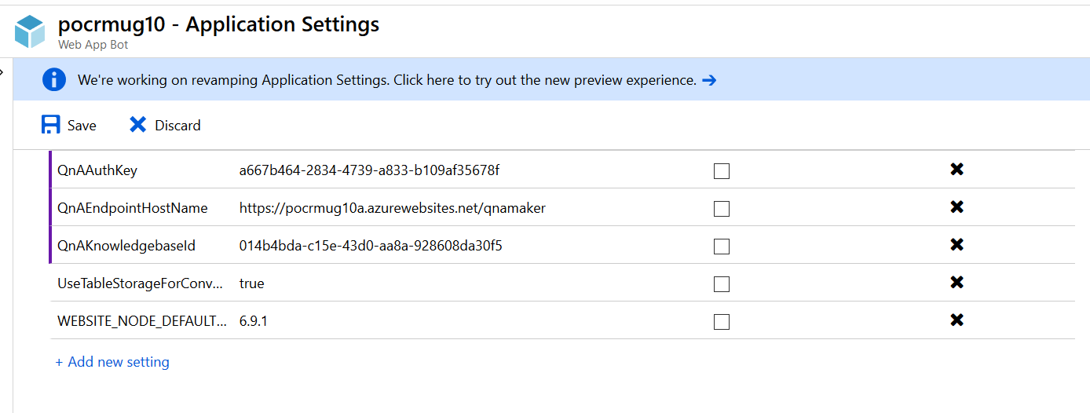
Chatbot -> QnA maker
In chat bot, properties, specify:

Slide 15
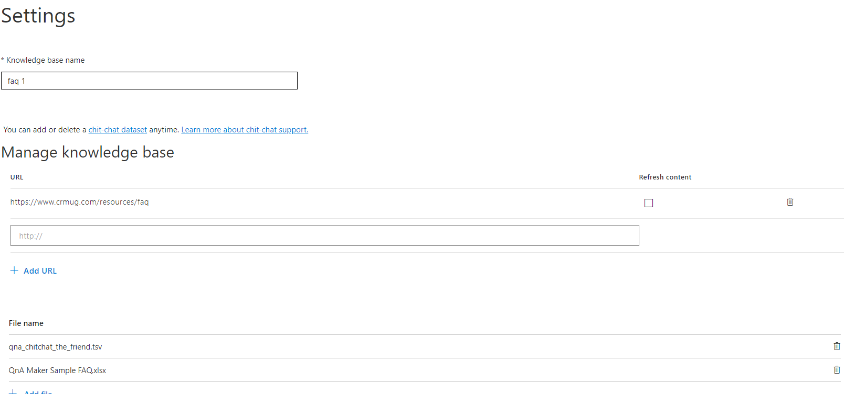
QnA Maker – Tip 1
Decide WHERE is the master – QnA maker OR outside QnA maker
You an mix types
URL
CSV
EXCEL
…

Slide 16
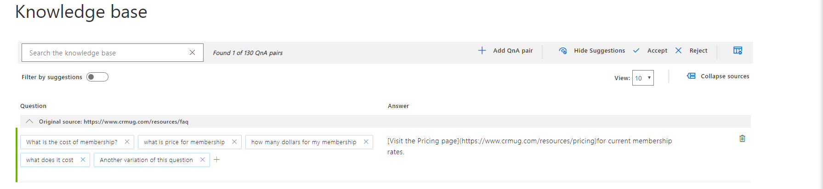
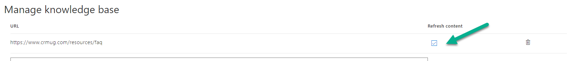
QnA Maker – Tip 2
Built in editor is very useful – but careful with URL sources
Refreshing from URL WILL wipe all changes done via editor on that knowledge

Slide 17
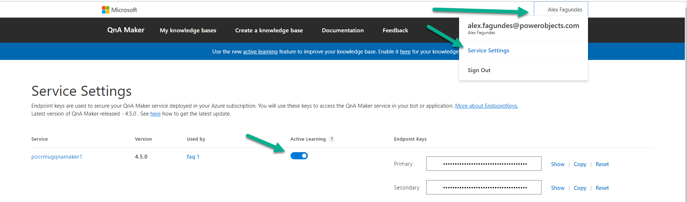
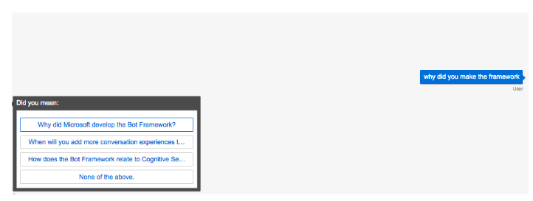
QnA Maker – Tip 3
Use active learning for internal bots – external ??
Explicit learning – ask the user when very close multiple matches

Slide 18
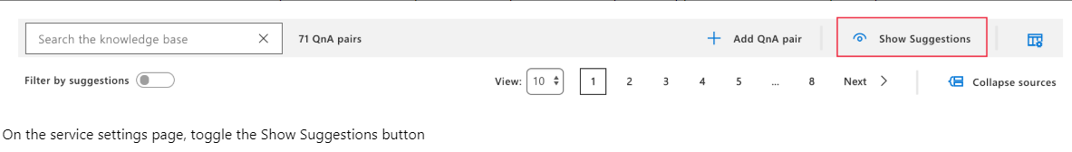
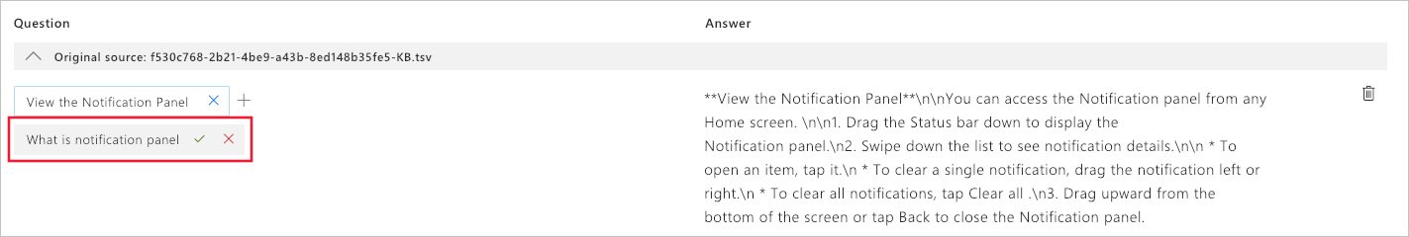
QnA Maker – Tip 3
Implicit learning – behind the scenes based on previous questions
You get to see the implicit learning and approve

Slide 19
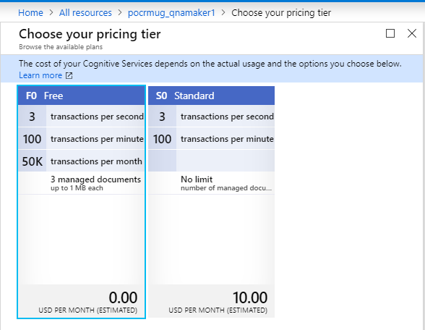
QnA Maker – Tip 4
Scaling
QnA Maker – only has 2 tiers
Max 3 transactions/sec
If we need more need to ‘double up’
Two bots – each tied to its own QnA Maker
Load balance traffic in front of web app
Scale search service – faster / more indexes
Tip – free search service can NOT be scaled

Slide 20
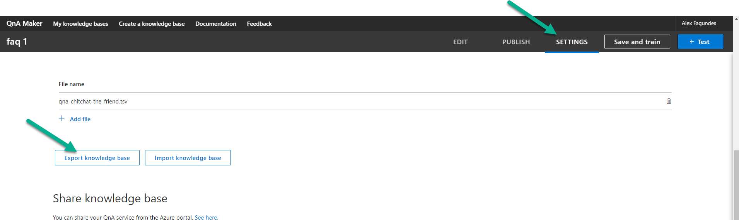
QnA Maker – Tip 5
Backup! Take backups before major changes / tweaks / etc.
Exports ALL sources – csv, excel, data from URL, etc. into single file

Slide 21
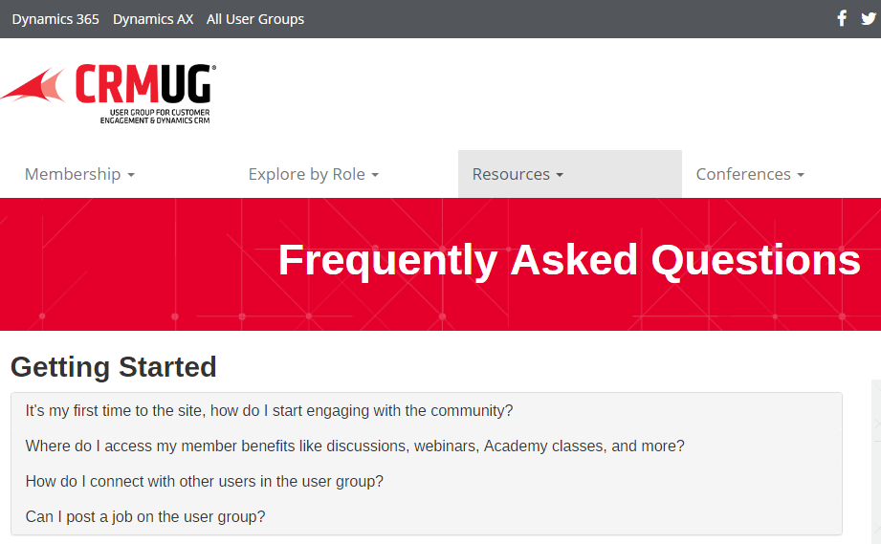
CRMUG FAQ Bot Demo

Slide 22
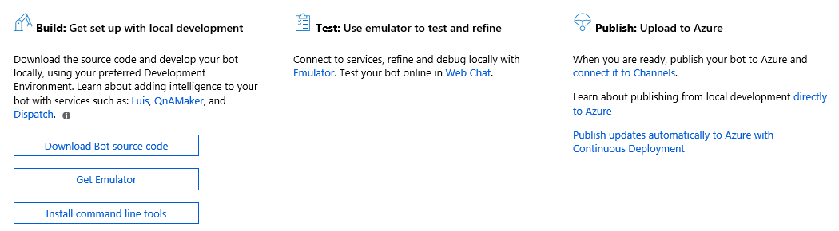
Extending The Base Solution
Produces .NET code
Need Visual Studio 2017 / 2019

Slide 23
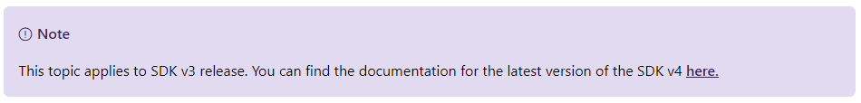
Extending Bots - Tip 1
Make sure you’re looking at SDK v4 documentation

Slide 24
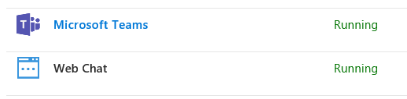
Extending Bots - Tip 2
Not all channels support all features
Some channels have specific features
https://docs.microsoft.com/en-us/azure/bot-service/bot-builder-channeldata?view=azure-bot-service-4.0

Slide 25
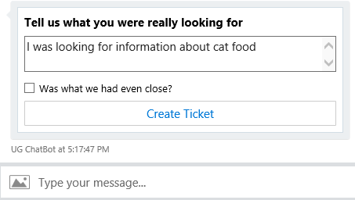
Extending Bots - Tip 3
Adaptive cards
Control layout
Different input types
Rich media experience
https://docs.microsoft.com/en-us/adaptive-cards/getting-started/bots
https://acdesignerbeta.azurewebsites.net

Slide 26
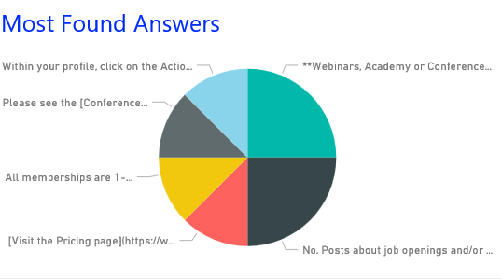
Extending Bots - Tip 4
Analytics
Basic analytics included
Use Application Insights to capture additional data

Slide 27
QnA Chat Bot
Show me the code
https://github.com/PowerObjects/POUGSummitEMEAChat

